Slide 1
2 - CONVERSATIONS
AND ME
Notes:
This section focusses in Courage and Curiosity.
Who am I in relation to conversations? Its often a really courageous act to ask these questions.

Slide 2

Introductions and Catch up
  Your name
  One thing I liked or used from the last session
  Something that puts you off having conversations

Slide 3


IN THIS MODULE
  Grounding - Body check- in.
  Challenges for care providers
  Trauma and talking
  How fear holds us back and what we can do about it
  Identifying and Using your Strengths in conversations
  Repair
  We are not alone

Slide 4
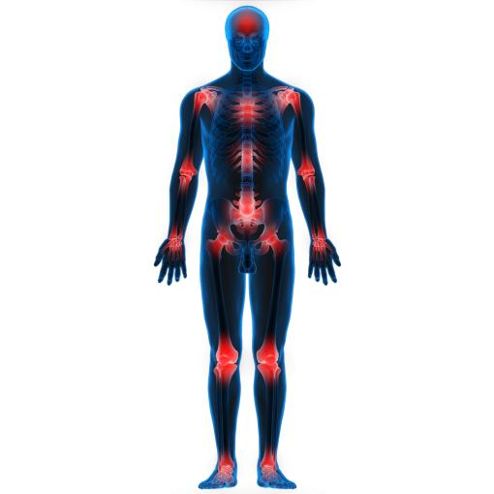
Grounding - sensing and relaxing
Plant your feet on the ground or
lie down if you can
We will tense each part of our body body in turn then relax it.
Throughout today’s training, if you feel a sensation in your body, notice it, remember it, and we can use it as information we will check in regularly to see if we can learn anything from our physical reactions today.
Notes:
Take them through the relaxation grounding. (See grounding handout)

Slide 5

WHAT DO WE HEAR ABOUT CARER'S WORRIES?
  Watch the film made by parents, practitioners and children. How can we talk about the fears and challenges felt by the care providers?
  Break into small groups and write down some of the worries you heard on the film
  How do you feel about your child's birth situation? The more honest you are now the more easily we will be able to come with great conversations.
  Please be prepared to share some of your answers with the full group
Notes:
https://youtu.be/cefYwSTRb0Q

Slide 6

QUOTES FROM THE FILM
  Hopes and fears exist side by side all the time
  The hope is they feel you are a safe space.
  If you bring it up too quickly they will shut down.
  She blames me a lot – its probably aimed at her birth mother. It gets me down but she must feel secure in our relationship!
  Did my mother have a choice to give me up? I didn’t know.
  Often, I feel on the back foot – I just tried to fumble it.
  She analyses everything far too much – she is ultra-sensitive
  How do I bring it round to none of this is her fault?
  If you push them the barriers are going to go up even more
  You don’t want to have a miserable ending to the day.
  Structure - how do we get started?
  What are some empathetic things to say?
  What are the aims of the conversation?
  It is difficult everyone is going to be difficult.
  You’re not locked into the conversation, there is an escape route at the end of it.
Notes:
A list of what was said in the film. Statements and questions are from all the different kinds of people in the study.
Many participants are at the very beginning of their journey - this slide is a look into a possible future for them.

Slide 7





I worry it is in their genes and won't ever get better
HOW DO I FEEL ABOUT MY CHILD'S PAST?
I'm not sure I can cope with it
I could kill them
They don't deserve positive regard
I want to tell him but I don't know how
I can't forgive what they did
How can they unlearn that stuff?
As a fosterer I have zero information which makes this important intervention impossible
I'm just
so sad
It hurts me to think about it!
So much trauma in that birth family
Hard to see through the negative tone of the police and SW reports
She idolises them and it makes me so angry and sad for her!
I've met them, they are scary and aggressive. Her not wanting to talk about them is normal!
She is too young to hear that
It makes me angry that I need to live with this behaviour
They don't deserve positive regard
I worry about his behaviour after talking about it
My fear is that she will get let down again
I think birth parents had a tough life
I am so frustrated by the lack of information!
Notes:
Here are some other things we heard in the research and in other fora

Slide 8
BODY CHECK-IN
As you heard the voices in the film, and talked in your groups about what has happened with the child or children in your care, what feelings did you get in your body?
Notes:
How we feel in our bodies tells us something. [if there is time I'll fill in more here from The Body Keeps the Score]

Slide 9


TRAUMA AND TIME
Recent work on intergenerational, collective and other kinds of trauma help give us a way to think and talk about the adults and ancestors in our children's past
  Bad behaviours in the present are often a coping mechanism learned as a child which have remained unchallenged by community and family
  Trauma can be passed on through stories and pain in families
  Unhelpful behaviours can be mimicked physically then work mentally on children
  Sometimes extreme stress in the adult can turn on genes which are inherited by the child.
Having compassion with our child's full history and lineage helps us stay in a place of calm and composure. Bad things happened at some point which have caused huge pain. We can now help ease that pain
Notes:
Thomas Hubl, an Austrian living in Isreal with his Israeli wife are writing and training extensively on collective trauma - the aftermath of war, slavery, local racism, geographic traumas like high-school shootings and so on.
An example of collective trauma: Some Pakistani children are genuinely bereft at the loss of a farm abandoned in partition over 100 years ago, but which has been described in loving detail down the generations. They display real trauma, yet this is something that happened in their community decades ago.
This is not their pain to hold.

Slide 10
DIFFERNT KINDS OF TRAUMA
  Personal Trauma - one off - being in a fight, a car accident, being mugged,
  Personal Trauma ongoing - domestic abuse, rape, gaslighting, mental ill health of ourselves or those around us,
  Intergenerational Trauma - a family history of being enslaved, migration, alcoholism and other addictions, family secrets
  Collective Trauma - something a lot of people experience - like a war, Covid-19, racial oppression, Climate Change.
  Systemic Trauma - a trauma held within and passed on through a system. A dysfunctional workplace, authority system (like the police), governments, oppressive regimes.
Exercise
Which, if any of these might you
hold in your body, or mind through experiences or the stories you have been told?
And which might your child be holding?
Notes:
Of these we say that the first two are often the most poisonous – they are experienced alone and it takes more for us to overcome them.
The difference between Personal One off trauma and ongoing is that we can often talk about and offload the first – it may be a bit embarrassing, but we can share with friends. Ongoing or long-term personal trauma is more difficult – we don’t want to be “boring” by going on about it, or it feels just too deeply personally shaming (even though friends would be the first to say “this is not your fault!”)
Some traumas, like racism are all of these.
A one off bullying incident on the way home from school,
Chronic racism in a school sports club,
knowledge of our heritage and culture in another country and the horror of what happened to our enslaved ancestors.
A deep knowing that simply by being this colour assumptions are made about us
Experiences of racism built into systems – like stop and search in the Police or the NHS where black women are assumed to be ’stronger’ and not need as much help. (There is quite a bit of research on this and there is a charity which works to improve the situation)

Slide 11
THE GOOD NEWS... !
We are able to overcome all these kinds of trauma with the help of family, therapists, friends and community. For example:
  Understanding epigenetics, a therapist Stephen Porges, was able to use creativity and talking therapies to quickly stop self-harm that had been inherited in an activated gene.
  When we learn that a behaviour doesn't serve us and are strongly encouraged to use behaviours that do work, we can change
  A family that knows about regulation can help us calm to a state where we can take in information and love
  Family therapy, “constellations” and other physical/working out processes allow us to “see” what we couldn’t see before and understand more fully our place in the world.
Notes:
Where a gene is turned on through trauma and passed down (epigenetics), the good news is that when this is addressed and made sense of by the child (even as an adult) it can totally disappear. This could be through talking or other therapy.

Slide 12


Having a coherent narrative
of adverse experiences has been associated
with recovery from trauma, particularly when there
is disruption of the narrative (Jirek, 2017)
WATSON, RICHES, STAPLES 2020

Slide 13

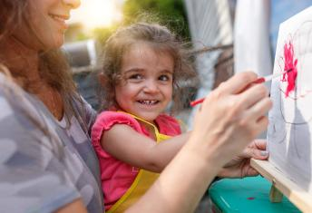
OVERBLOWN STRENGTHS Exercise
In conflict resolution we say that every challenging behaviour is an overblown strength. So we can then:
  Name the strength we see to ourselves as the facilitator /adult in the situation. Anger – Leader. Nitpicker – getting it right.
  Name the strength to the individual - they then feel heard and acknowledged.
  Where conflict or bad behaviour is being observed by others, we can name the strength to the audience who then shift mindset.
  Elicit help from the person... give them a job that uses the strength
Exercise - Imagine someone you find very "difficult”. In pairs discuss what annoys you. What is the positive intent behind their behaviour?
Notes:
1. The shouter is passionate about the issue. The nitpicker wants everything to be right.
If we re-frame how we think about that person, it a) makes it easier for us to cope and b) allows other people to see how we are dealing with the situation and they copy.
2. "I can see that accuracy really matters to you and you want to get this right". "I hear you are taking a stand and really protecting [this process/the family/your space]." Sometimes this makes the difficult behaviour stop altogether. The acknowlegement is enough - being seen. It can be a shock to people to be heard - sometimes they will start to cry. (which is a sad enditement on our social structures!)
3. Also, if we name the strength in front of others, they will tend to follow our lead and start treating that person as useful rather than annoying. We have seen their strengths, now other people can name their strengths. When we take on the role of calm leader this is even more effective.
4. an example of a task. If a set of rules is being written, you could ask a person who is very exact to write down what people are saying. Or someone who is vocal about an issue could be asked to be on a group which talks further about that issue and works on a plan. We don't ask them to do things by themselves - they idea is to bring them into group/family and work together.
NOTE: People rarely see themselves as challenging. NON-TRAUMATISED people are far more likely to think of themselves as the positive version, so if you think you might be patronising, you probably won't. An angry person gets up in the morning and doesn't see themselves as angry, they see themselves as a "challenger" or even "leader"
TRAUMATISED people need to be reminded that the behaviour they are displaying is useful - just at a lesser pitch. Also, that very behaviour may be exactly right in a different context (ie when they learned it in neglect or abuse). This behaviour may have saved them previously.

Slide 14

Tea or Coffee break

Slide 15
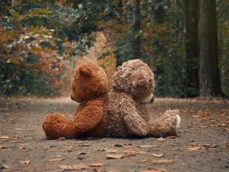
Fear
"The greatest danger we face is our tendency to retreat from conflict, to accommodate it, and adapt to it”
(Kenneth Cloke - Mediator and Author, 2001 )
Notes:
Running away from fears doesn't work - getting support to get to the other side does.

Slide 16


Uncertainty Cycle
Hostility/ Conflict
I’m overwhelmed or angry and liable to hit out. It’s difficult to take in information.
Uncertainty / Anxiety
What’s going on now? I'm feeling very worried and it’s taking a lot of brain-space I resent the amount of time this takes and I don't know what to do.
Fear
It’s hard to think clearly. I think or know I need to do something and don't want to /don't know how which scares me.
Notes:
Uncertainty stokes fear (of action, or inaction), Fear left to fester or set off by an intervention can set off hostility. Hostility is chaotic and often un-thinking and breeds even more uncertainty.
Where we break this cycle is at uncertainty. We research, talk, make relationships, visit, get help – essentially we are curious and courageous and surprisingly quickly this cycle can be broken.
The more embedded the responses – either in the body (from early trauma) or the brain (from repeated stories and self-talk), the more times you need to help break they cycle at uncertainty.

Slide 17


Iceberg Diagram - 1
Positions
Interests
Needs
Notes:
Positions are the kind of thing you see on a placard - "build the road" vs "don't build the road" - compromise seems impossible - you can't half-build a road. Similarly "I can't bear to tell my child their past" vs "I know my child has to know about their past". How can we make that work?

Slide 18
Iceberg Diagram 2
Positions
Interests
Needs
Notes:
Interests lie below positions and when we ask "why" once we get reasons and issues. "The information is not appropriate for a child" or "I don't want those images in her head" vs "its her right to know her history" "children who have been through it tell us they want to know"

Slide 19
Iceberg Diagram 3
Positions
Interests
Needs and Fears
Notes:
Both position 1 and position 2 have the same root - I want to keep my child safe. I want my child to be happy. We find that the bits where the two seemingly opposing ideas overlap are bigger than the positions themselves. They centre around love, support, happiness, positive development, security etc. Often the difference between the two positions is about timing. One is focused on the now – how their behaviour will be today, tomorrow if we have a conversation. The other on later life – how calm/distressed they will be depending on what we do now.

Slide 20
BODY CHECK-IN
As you do the following exercise, notice how your body responds as you think about times you were in conflict. Where do you feel it? stomach, head, face, jaw, Butterflies or tighteing? We are all different. Notice your own body responses. Are there any patterns?
Notes:
Why are we doing this? So that you can begin to build a sensory awareness of how your own stress, disgust, worry, feel in your own body. The more we practice noticing them, the more useful they become – like an early warning system that can stop us going too far, saying or doing something we may regret. And sometimes we all get it wrong.

Slide 21

FEARS - EXERCISE
Draw a couple of icebergs (overlapping triangles on a sheet of paper
Two seemingly conflicting ideas/wishes on your mind
Now ask "why?" By the time you have asked "why" 5 times you will be in the area of commonality - values at the root of both ideas from which you can work outwards.
"So, if we want a situation that serves everyone, where can we start to work?"
Notes:
The iceberg diagram or PIN diagram as it is called is also used for the positions of two different people.
When we start thinking about what is common to both sides of the argument (the needs), we can begin to work together, come up with solutions that we all agree with and thus build the common ground.
Eventually the sides become used to working together and the value of working togther (the triangle) is worth more to the sides than the original Positions they took.

Slide 22

WHAT CHILDREN AND YOUNG PEOPLE TELL US ABOUT ADULTS AND DIFFICULT CONVERSATIONS
  many feel adults are "dancing around the issues"
  when they have chosen to talk to someone they knew and feel comfortable with, being told to talk to another adult (largely due, often wrongly, to safeguarding and other fears)
  "Having difficult conversations - it's never straight to the point, it's always a long-winded process"
  "my dad hesitates a lot, so it's like he doesn't know"
  "I feel really bad because even she didn't realise we were going to be with her for such a long time" - guilt about already being a burden to a foster carer.
Notes:
To help you come up with some really great conversations, these are the kinds of things children are thinking and feeling - to be aware of.

Slide 23


Strengths Inventory
What are your strengths?
What are your relational and conversation super-powers?
Notes:
So how can we use our own strengths to do what our children need?
In small groups discuss how it felt to be part of the previous conversations

Slide 24
USING STRENGTHS TO OVERCOME TRIGGERS
On your own think about your own life for a couple of minutes.
- From what you know about trauma are there any beliefs, behaviours, or other characteristics you might be bringing forward into your own parenting?
- Are there any that may be holding you back from having conversations about your child's past?
In pairs have a chat about your fears and how your strengths might help you . What do you notice that you can share with the group?
Difficult Conversations with Children ©

Slide 25

USING YOUR STRENGTHS ...
TIP 1 Where you use your natural strengths you will be more relaxed and so come across as authentic
TIP 2 Throughout this course, in the reflection time, consider your strengths - what suits you most out of that module? What matches your natural strengths?
TIP 3 Relax - be confident - its the main thing our children want from us.
Difficult Conversations with Children ©
Notes:
1. Our children have super-powers when it comes to detecting truth and integrity in people.

Slide 26

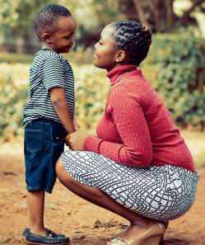
AND DON'T WORRY IF IT "GOES WRONG..."
...Because it gives you a chance to model "repair"
If its all gone wrong and you have both dysregulated....
  Take a breath – can you go on? If so do, if not take a tiny break and come back when you are calm
  Wait until your child can begin to regulate
  Don’t plan the repair too much but do have a starting point in mind - it will often be co-created.
  If there is an action to take as an agreement of the repair, do it immediately.
  Say a phrase and movement that properly ends the repair. High Five, “Tomorrow is a new day”,
Difficult Conversations with Children ©
Notes:
It may not seem it at the time, but when we mess up, notice and do something about it, this process is experienced and taken in by our children. We know from the research that observing us doing something difficult and thoughtful is very much noticed by our children.
We don't want to dysregulate in front of our children, we always want to catch both us and them before it happens, however, sometimes we all get it wrong.
Standard adoption training tells us to stay and have "time in" with our child, however some children do better if you go into another part of the room or the kitchen to gather your composure. If they have decided you are the "cause" for the upset (common in some children), the upward spiral will stop.
1. if the child comes back first don't be tempted to talk/repair before you are fully ready. Cuddle, but don't broach the subject until you feel ready.
If the child is still very dysregulated help them get regulated.
2. This is another great opportunity for procrastination. Just launch in... " Do you know what, I handled that really badly, now I feel awful". My son ofter comes up with a "solution" from his repertoir of sensory fixes - like to be pressed with a pilates ball, or have my arms stretched or have a chewy sweet.
3. If there is an action to take, do it immediately (mutual rolling with a pilates ball, watching an episode of a cartoon, finding some chewy fruit).
It gives them a chance to think through dysregulation without being in their own dysregulation. It also lets them know that they are not strange to have these feelings. Its normal and we learn from them.
Its not patronising to say the "opportunity" to repair. How great is it for the child to come up with a solution for our dysregulation! Its amazing how quickly they get to green if their "job" is to think about how they can "help" us.

Slide 27

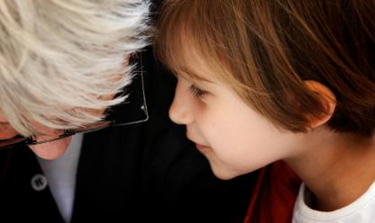
HELPFUL PHRASES
When you are dysregulated its the hardest time to come up with empathetic phrases... so here are some.
  It must feel hard to be you right now
  I'm here for you when you need me [and physically be wherever you say you will be]
  Good job for ...talking to me/holding all that in until the right time/letting me know
  Oh no, do you know what, Mummy is going red... what am I going to do?
  I've just noticed, I'm in yellow.... I need to sit down before I turn into an ogre and bite your bum!
  OK, I'm going to tell you a secret.... I feel scared too sometimes ....
  I'm trying to think.... how would superman solve this?

Slide 28
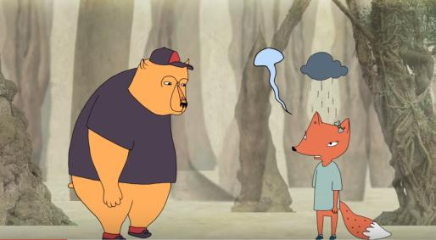
EMPATHY VS SYMPATHY
A short cartoon to an excerpt of a Brené Brown talk which explains clearly the difference between empathy and sympathy
https://www.youtube.com/watch?v=1Evwgu369Jw

Slide 29
WHAT OTHERS ARE DOING - TRAUMA
Sometimes it feels that all the onus is on the parent and carer and that you carry a lot alone. Here is where others are doing to change mindsets and policy around trauma:
Ace Study and follow up into policy
Oprah Winfrey and Bruce Perry – helping everybody understand about trauma
Brené Brown on vulnerability and empathy
Paralympics popularity – being different can be being great.
Campaigns like MeToo,
Pocket Project and Collective Trauma – training, healing and awareness raising
Difficult Conversations with Children ©
Notes:
the ACE study was done 22 years ago and after being ignored for a long time recently found its way into core policy. Experts think it was probably the best public engagement tool that the field of trauma has had in a long time.
Bruce Perry and Oprah Winfrey have got together and written a book about developmental trauma which they are publicising world-wide
Brené Brown (who originally studied social work) encourages leaders of all kinds to understand and value vulnerability, resilience and empathy
Since the Paralympics in the UK 2012,
Black Lives Matter, Me Too and successful public engagement on Autism (with Dramas like The A word) there is an increased awareness in the media and public of difference and privilege in general.
Thomas Hübl’s Pocket Project and Collective Trauma Summit teach therapists, teachers, professionals and carers about the deep origins of trauma and the best ways to interact with each other to heal it.
Adoption UK has written a slide which can be found at the end.

Slide 30
WHAT OTHERS ARE DOING - ADOPTION AND FOSTERING
Here is where others are doing to change mindsets and policy and support you in fostering and adoption.
  Use of language in documentation - policy changes and guidance
  Podcasts - you can hear directly from children and young people about what worked for them.
  Webinars and conferences on adoption/fostering websites – including specials for teachers/support workers/family members
  Themed or non-themed access to “experts” - eg the Trigger clinic by the Association of Therapeutic Parenting.
  TESSA - a pilot training course from Adoption UK which is open to including family members at certain points.
Difficult Conversations with Children ©
Notes:
Use of language is TACT – in the resources and has a link in a later module about language
Podcasts are found on the Children’s Commissioner’s website.
TESSA includes as part of the process, a long conversation with a psychologist to discuss how adopters were parented and try to identify some triggers for them around conversations -

Slide 31



Timing tips (check!)
ME AND CONVERSATIONS
Be child led - sometimes the timing will not be of your making. Get comfortable with rolling with it.
Have your child's life story book (if it's detailed) or full details from the social worker available in a safe place - pick out one tiny bit of information to float at the next conversation
Put an alert on your phone to check you have mentioned something, made one reference to birth family/culture/history/skill /biology that week.
Difficult Conversations with Children ©

Slide 32

REFLECTION TIME
Work alone, with your co-parent or in pairs
  Apart from your child, who might you have conversations with about helping your child build their identity gently by acknowledging and safely holding their past?
  Have you learned anything new so far?
  What do you most look forward to in the training?
  Do you have any questions?
Difficult Conversations with Children ©

